Slide 1
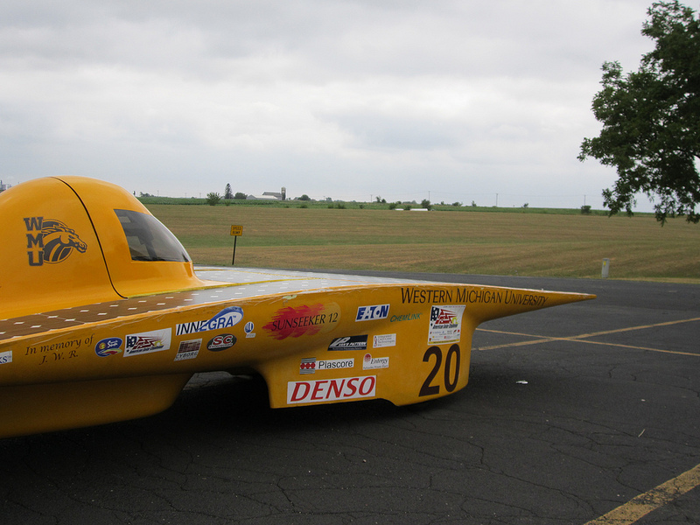
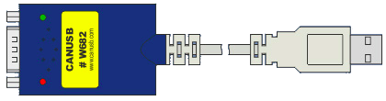
Sunseeker CAN
George Barry
James Dilts
Kyle Noll

Slide 2
Sunseeker CAN
Background
Design Goals
Design Decisions
Implementation
Testing

Slide 3
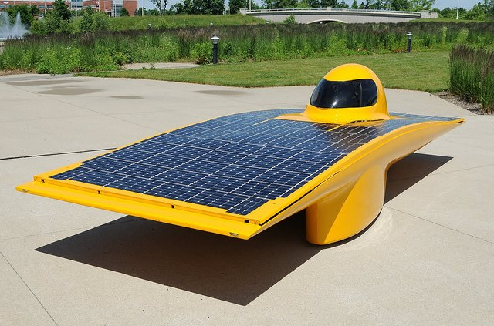
Introduction
WMU Sunseeker Solar Car Team
Founded in 1989
Competes in:
  Formula Sun Grand Prix
  American Solar Challenge

Slide 4
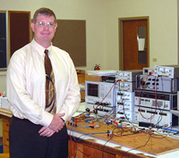
Introduction
Dr. Brad Bazuin
    Sunseeker Advisor
    Associate Professor
      Electrical
      Computer Engineering

Slide 5
Controller Area Network
(CAN)
CAN is a multi-master broadcast serial bus standard for connecting Electrical Control Units
Priority based bus arbitration
Devices communicate without a host controller
Speeds up to 1 Mbps
Adopted by Society of Automotive Engineers in 1986
CAN bus is one of five protocols in the OBD-II standard
OBD-II is mandatory on all cars sold in the U.S. Since 1996

Slide 6

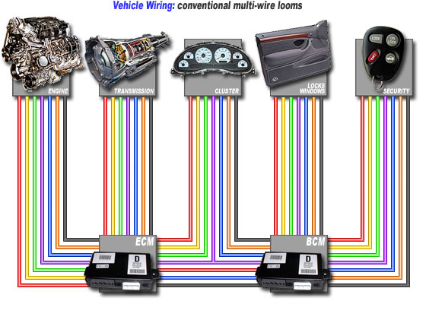
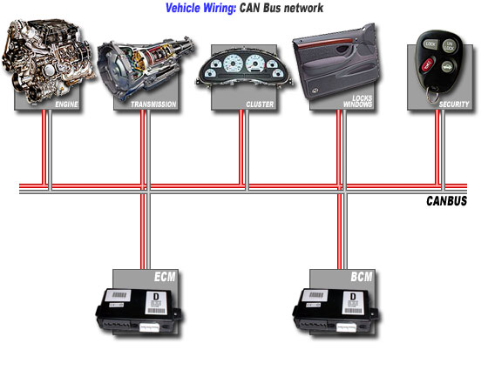
Controller Area Network
(CAN)

Slide 7
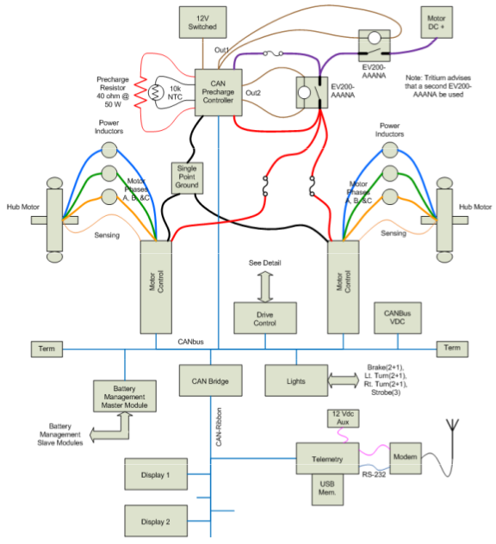
Background
Connections
    Motor Controller
    Driver Controller
    Motor Precharge Controller
    Driver Displays
    Battery Protection System
    Telemetry
    Light Controller

Slide 8
CAN Message
SOF = Start Of Frame
Message ID = Message Identifier (Priority)
RTR = Remote Transmission Request
Control = Control Field (Data Field Length)
Data = Data Field
CRC = Cyclic Redundancy Check
ACK = Acknowledge Field
EOF = End of Frame

Slide 9
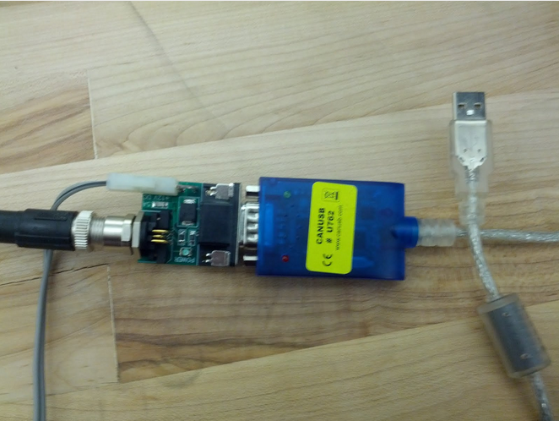
Background
Previous Solution
    CANUSB adapter
    Windows XP PC
    Lawicel Sample Application

Slide 10

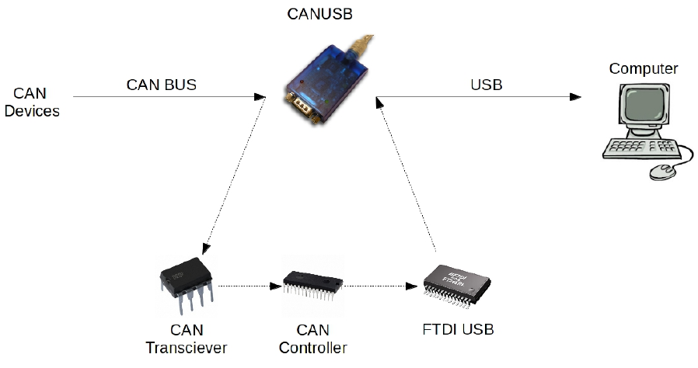
CANUSB

Slide 11
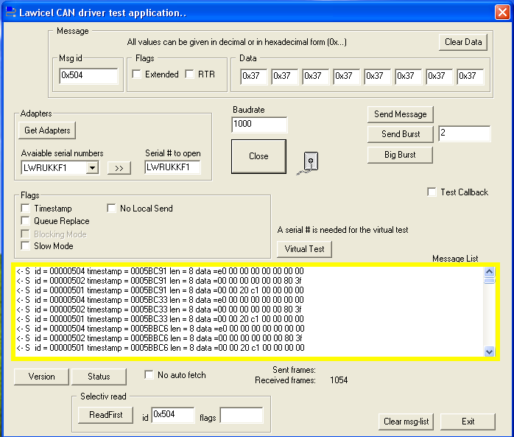
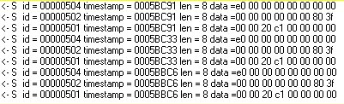
Lawicel Application

Slide 12
Lawicel Application
  Hard to
      Find correct id
      Read message

Slide 13
Previous Solution
Run the UI
Manually Highlight
And Copy Messages
Paste Them
Into a Text File
Convert Text File
Into Spread Sheet
Perform Row
Operations
View Message
Data

Slide 14
Background
Problems
    Extremely Time Consuming
    Unneeded Messages
    Outdated Messages

Slide 15
Design Goals
Format the messages to be easier to read
Filter unwanted messages
Log the messages

Slide 16
Design Decisions
What driver to use
What language to code in
Layout of the new User Interface (UI)

Slide 17
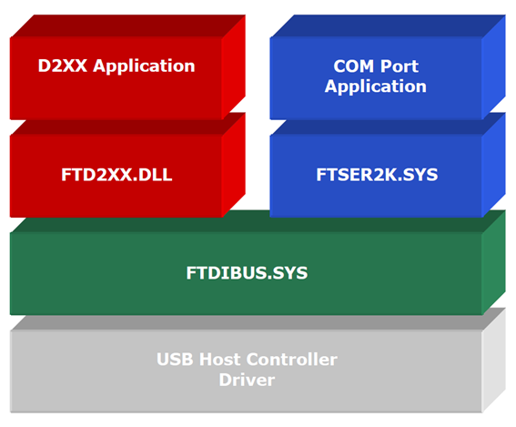
Design Decisions
FTDI2XX Proprietary Driver
    Full Proprietary FTDI Calls
    Easy to use API
    No Time Consumption

Slide 18


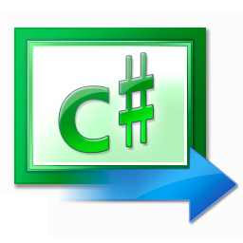
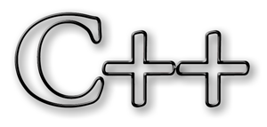
Design Decisions
Languages

Slide 19

Design Decisions

Slide 20
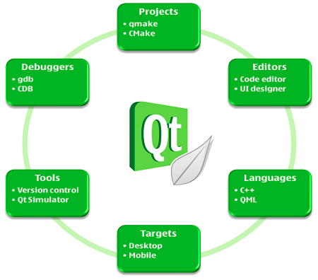
Design Decisions
Version Control
Qmake and cmake for make files
Q thread for cross platform threading
Integration of coding and UI design

Slide 21
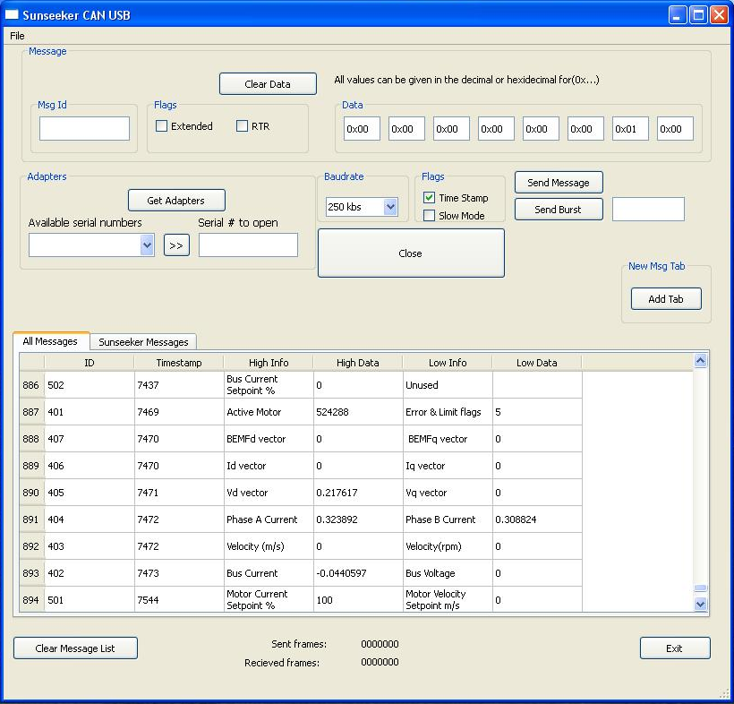
Design Decisions

Slide 22
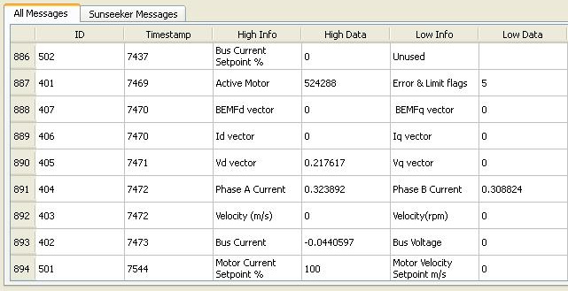
Design Decisions

Slide 23
Design Decisions

Slide 24
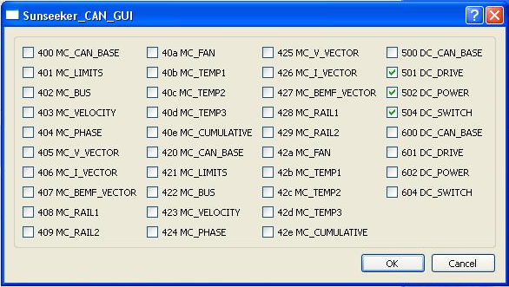
Design Decisions

Slide 25
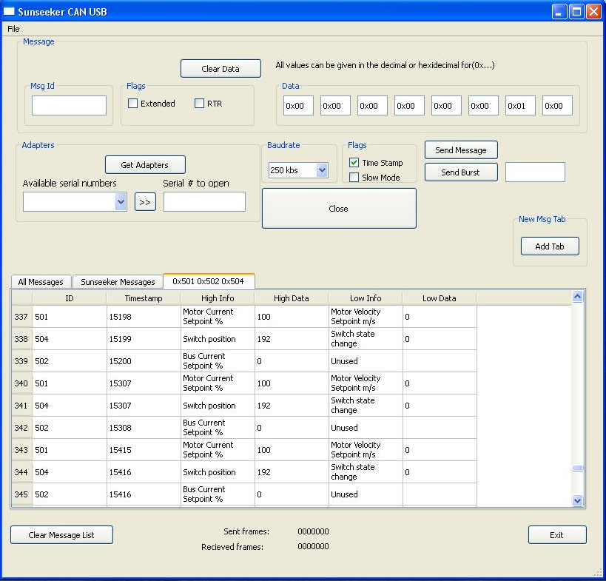
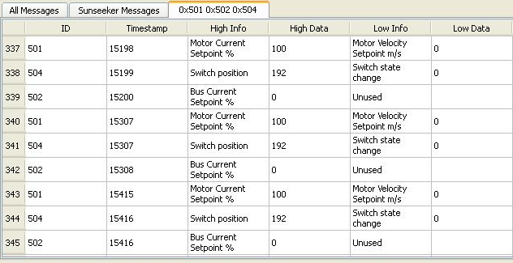
Design Decisions

Slide 26
Sunseeker CAN
Implementation
Testing
Future additions

Slide 27
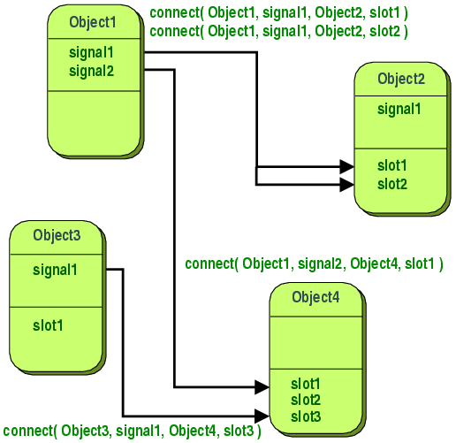
Implementation
Signals and Slots
  Thread Safe
  Signals can be connected to slots or another signal.
  Signals can be connected to multiple slots.

Slide 28
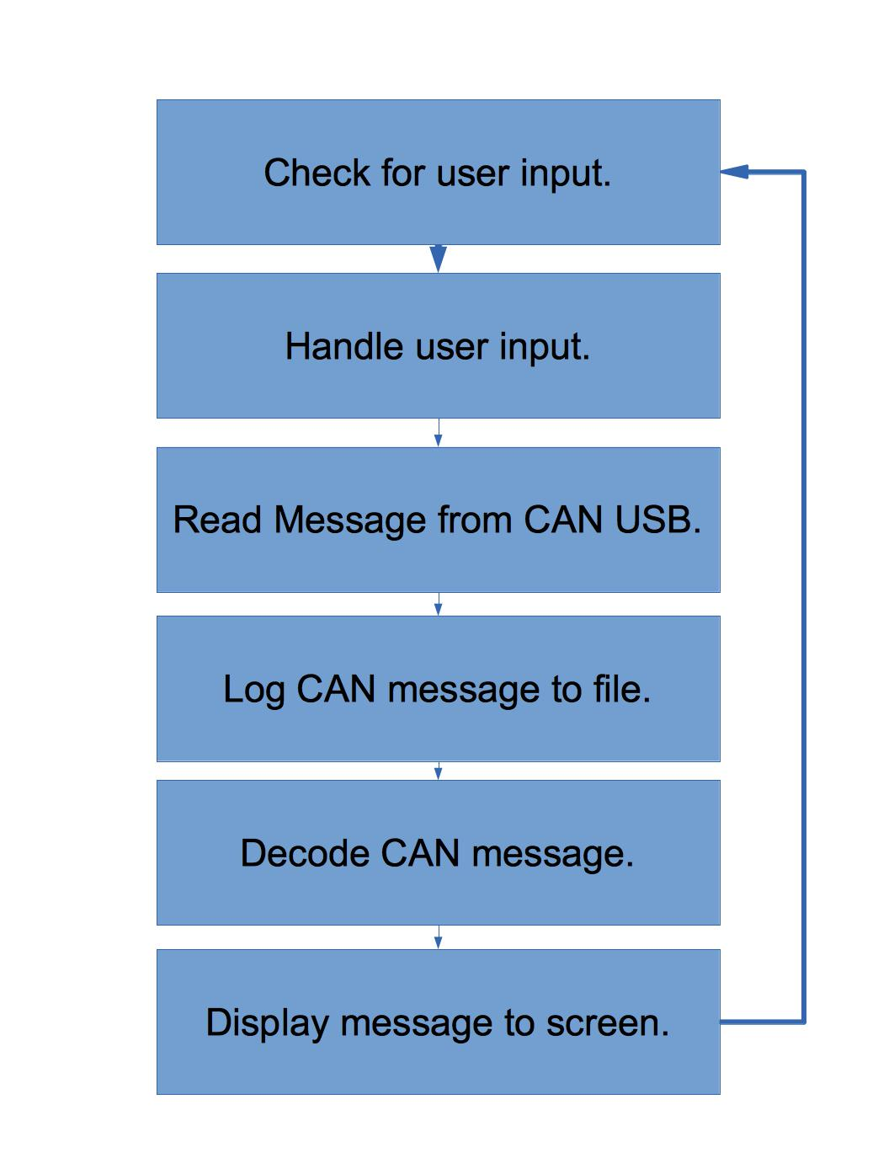
Implementation
Process Flow
  Excessive time spent processing data.
  User interface lags.

Slide 29
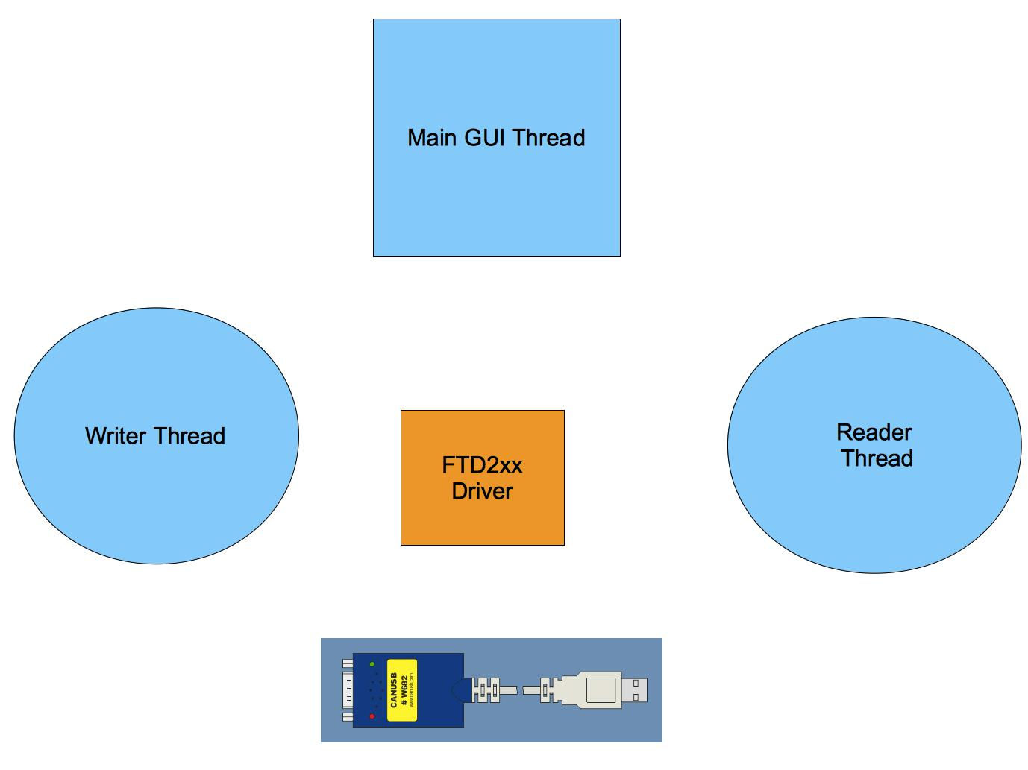
Implementation
Threads for UI, reading, and writing.
Each Thread has its own event handler.

Slide 30
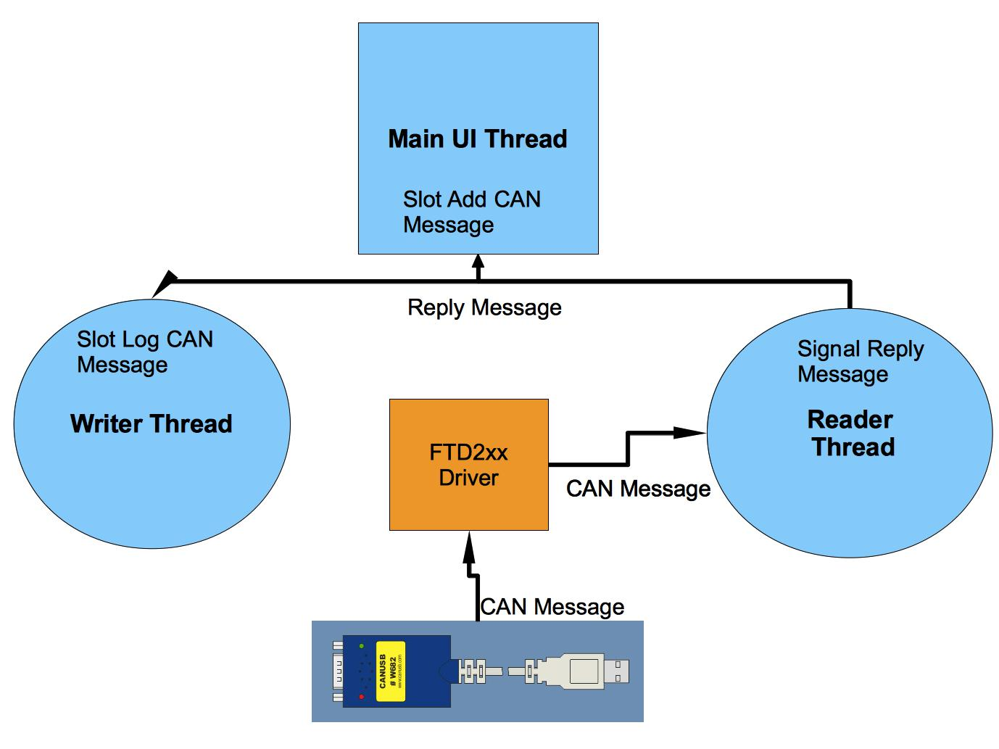
Implementation
Reading A CAN Message
FTD2xx driver reads a message from the CAN USB queue into the reader thread.
Reader thread emits signal for new can message.
UI thread and writer thread receive signal containing new CAN message.

Slide 31
Implementation
Memory Management
  C++ vs C# or JAVA
    Garbage Collection
  Qt Parent Child Relationship

Slide 32
Implementation
Memory Management
  Selection Dialog
    Checkboxes
    Buttons

Slide 33
Testing
QTest
    QT Unit Testing Framework
    Allows us to test our UI elements

Slide 34

Testing
Valgrind
    Detects memory leaks.
    Writing to undeclared memory.
    Finds threading bugs.

Slide 35


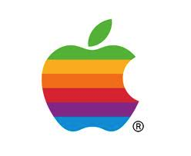
Testing
Able to run on
    Windows
    Linux
    Mac

Slide 36
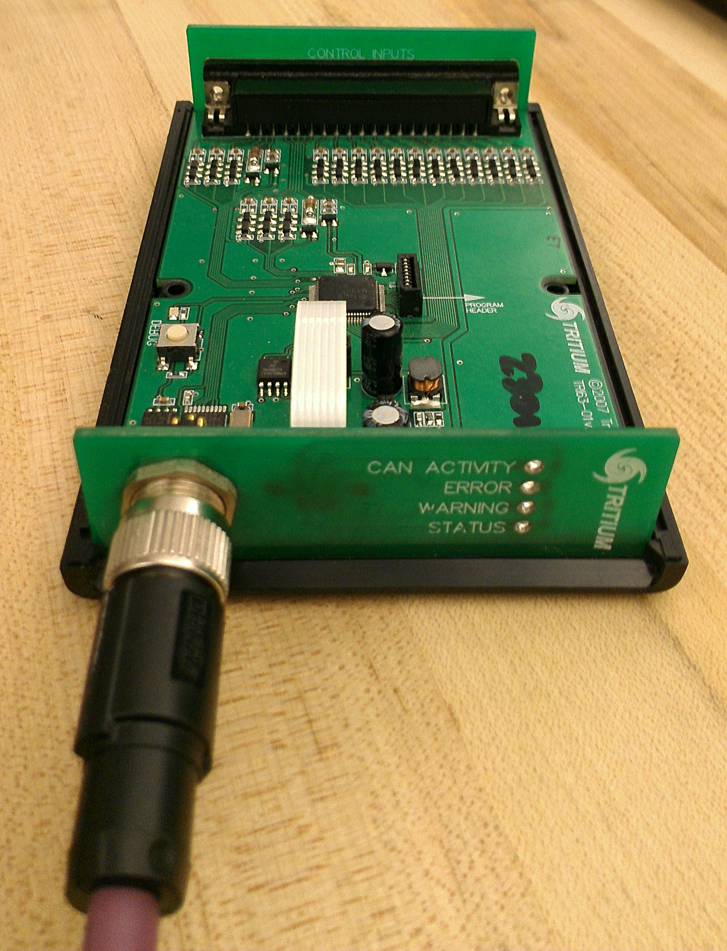
Testing
Able to run on
    Windows
    Linux
    Mac
Test under maximum rate
    Overloading messages

Slide 37
Implementation
Possible future release goals
    Digital gauges inside the cockpit
    Automated message returns
    Wireless connectivity
    Mobile Application Support

Slide 38
Sunseeker CAN
Thank you

